Slide 1
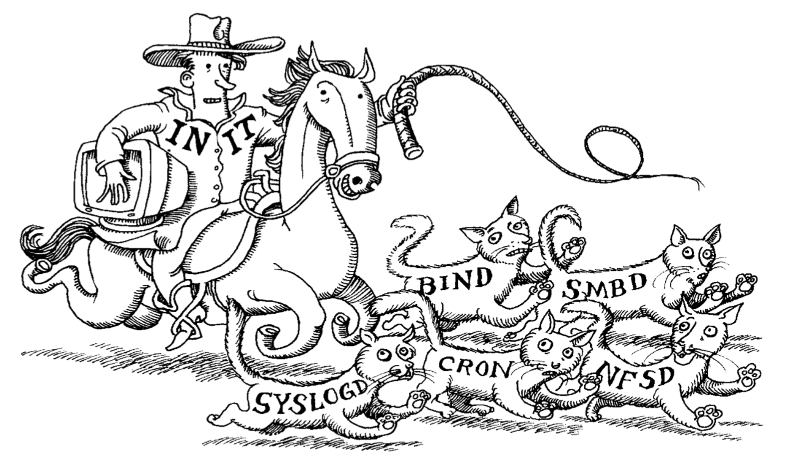
Linux Boot Systems

Slide 2
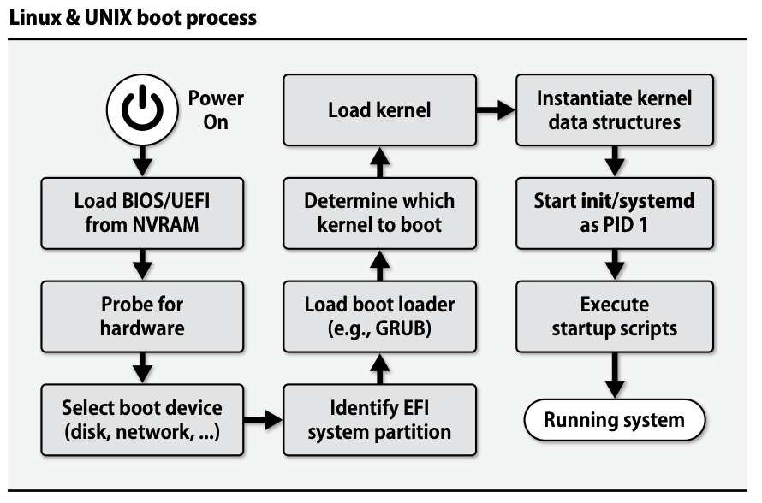
Notes:
Extensible Firmware Interface (EFI)

Slide 3
Three Booting Stages (Basic I/O System - BIOS)
Master Boot Record (MBR): Loads the secondary boot loader from a very small special region of memory (deadzone) before
Secondary Boot Loader
Usually GRand Unified Bootloader (GRUB) which lets you choose which partition to load as the OS
GRUB loads the secondary bootloader for the specific OS which loads the OS kernel
OS Kernel: The core functionality for your operating system
This is being replaced by Unified Extensible Firmware Interface (UEFI) which covers both MBR and secondary boot loader with some extra features

Slide 4
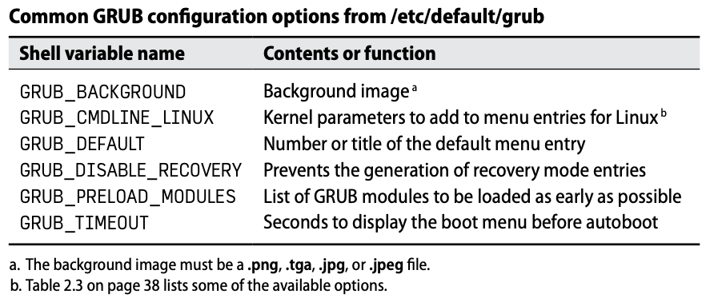
GRUB
Understands file systems giving it access to enough memory to load the OS
Reads a configuration file usually at /boot/grub(2)/grub.cfg
Can be configured with the utility grub(2)-mkconfig
Config is often re-created during OS updates, so you may need to take action to stop custom grub.cfg files from being overwritten

Slide 5
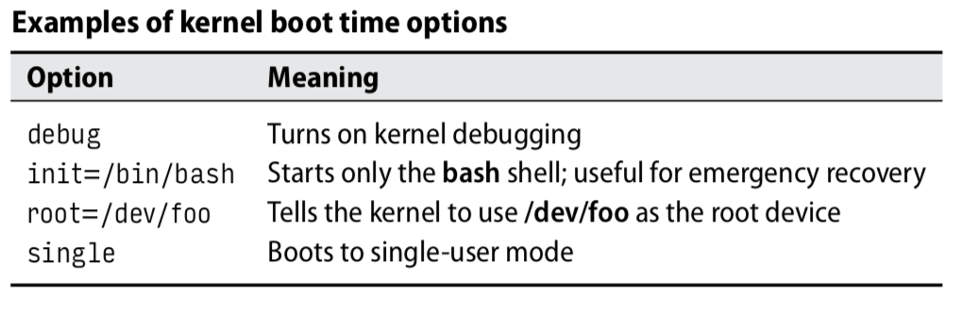
Kernel Booting (Init/Systemd)
Kernel starts a single init or systemd process with a PID of 1
This process spawns all other processes in the system (using fork)
Options for booting specified in /etc/grub.d/40_custom or /etc/defaults/grub (GRUB_CMDLINE_LINUX variable)
Systemd has become the new standard so it will be our focus

Slide 6
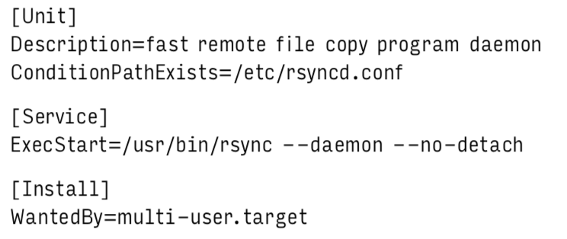
Systemd
Anything managed by systemd is known as a “unit”
Each unit describes some boot item or a boot requirement
services, sockets, devices, mount points, partitions, timers, etc.
Stock systemd units located at (/usr/)lib/systemd/system
Custom systemd units should go to /etc/systemd/system

Slide 7
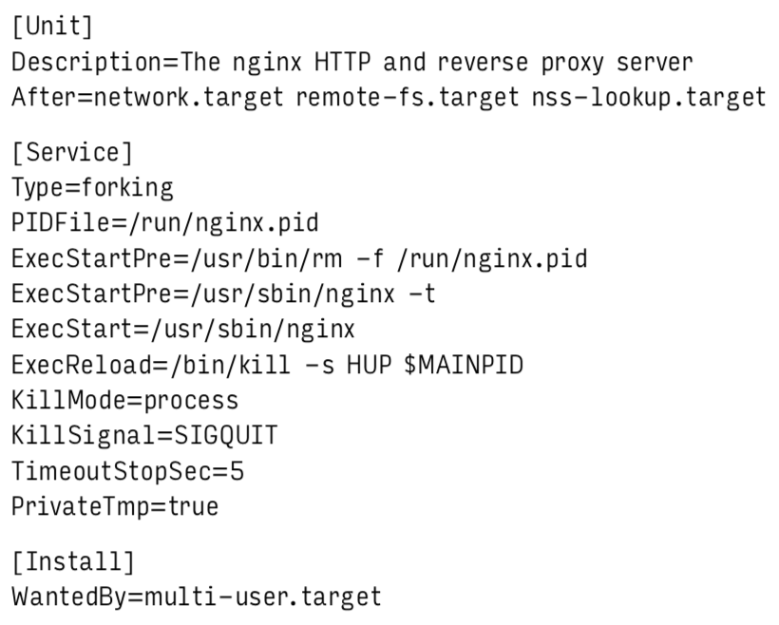
Unit Files
Describes dependencies between other units and targets
Describes relative ordering between dependent units, allowing for parallelism
Describes various modes of operation
Can handle preparation and post-death cleanup
Lots more...

Slide 8
Unit Files
[Unit] Section
Starts with a description of the process
After lists other targets which this process requires to be able to run

Slide 9
Unit Files
[Service] Section
Type defines its running condition, here forking means the daemon should keep running even though the process finishes
Daemon PID is recorded in PIDFile location, since forking means systemd won't have created the daemon directly
Exec lines show commands to run during various forms of execution (pre, start, reload, etc.)
KillMode and KillSignal state that a QUIT signal should terminate and clean up
PrivateTmp is for security reasons and puts the /tmp directory someplace users can’t freely access it

Slide 10
Unit Files
[Install] Section
WantedBy links this unit with a target, so when the target is enabled this unit will be linked
This allows the target to stay relatively clean but to be extended from the outside

Slide 11
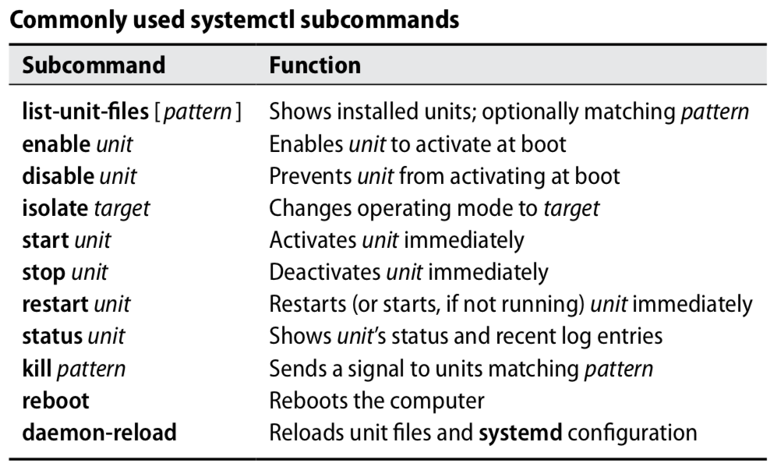
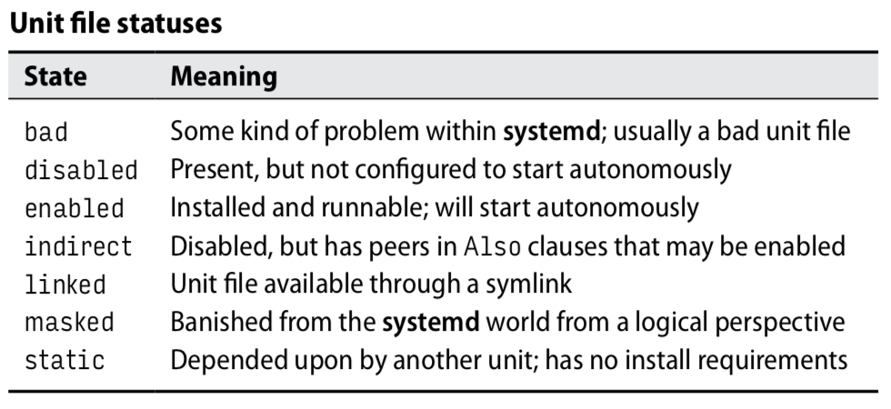
systemctl
Allows you to investigate and modify systemd
Systemd unit file describes what it does, systemctl enables/disable it to run at boot

Slide 12
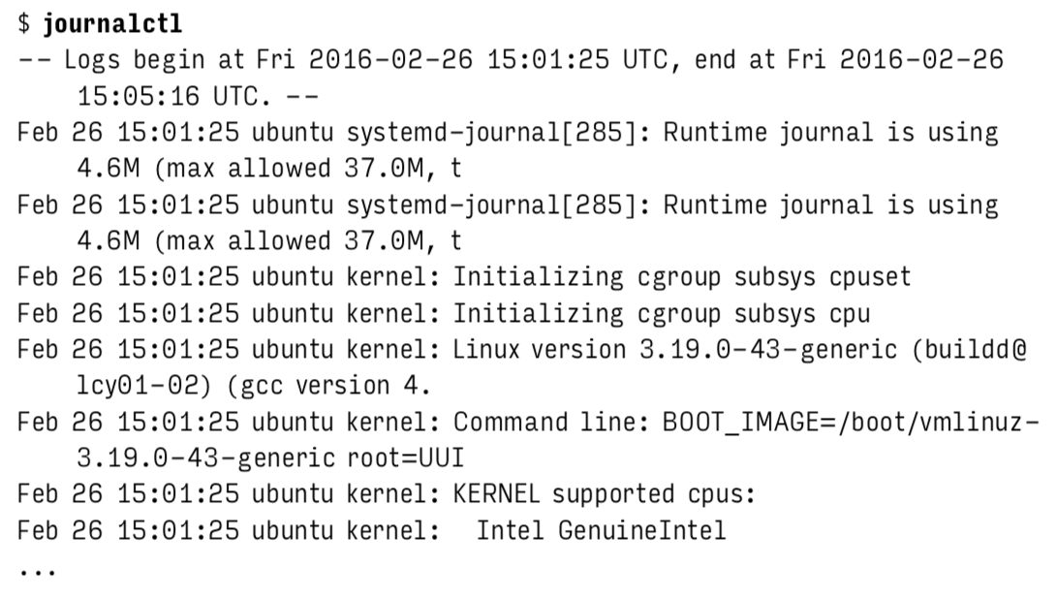
Journald and journalctl
Journald is a system paired with systemd that logs for all the units under systemd control
Use journalctl to read these logs (located at run/)
Notable flags: -b X allows you to go back to a previous boot (negative number) or a specific boot (boots hash) -u X allows you to look for a specific unit (service name)

Slide 13
Shutdown Procedures
Shutting down a system is governed by three primary commands:
halt: performs necessary shutdown procedures, logs the shutdown, kills non essential processes, flushes cached filesystem blocks to disk (add -p flag to power off the system as well)
reboot: this performs a halt and then causes the system to boot again
shutdown: allows for scheduled halts and reboots and prints warnings to users that the system will soon become unavailable

Slide 14
Strategies for Non-booting Systems
Don’t debug; just restore the system to a known-good state
Always possible assuming you have backups of your system
Depending on what you backup and what you need to restore, may be costly
Bring the system up just enough to run a shell, and debug interactively
Use single-user, rescue, or emergency mode to bring up all little as possible before a shell
May not work in the case that the bug is very early in the boot
Doesn’t boot network, so requires physical access to the system
Boot a separate system image, mount the sick system’s filesystem, and investigate
Requires the installation of a new system image in addition to the sick one
Gives you an external view of the system, which may make some issues more difficult to trace

Slide 15
Questions?

Slide 16
Additional Resources
Digital Ocean: Understanding Systemd Units and Unit Files

